Slide 1
Map Types
By Itzanami Baltazar
1st period
Mr. Bazemore’s Class

Slide 2
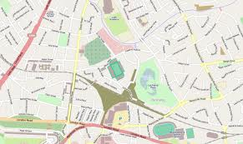
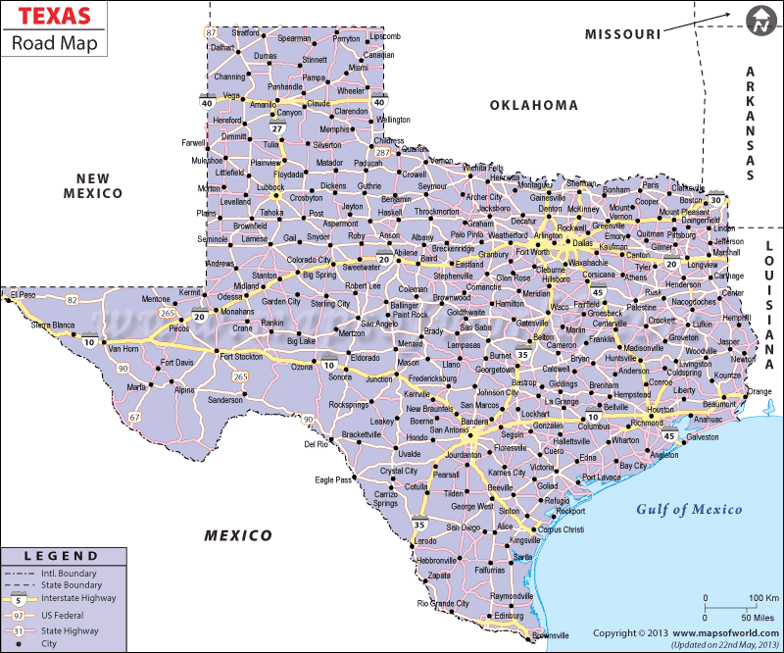
Road maps
Road maps- showing the roads of the city, state, and other area

Slide 3
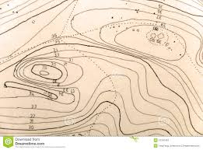
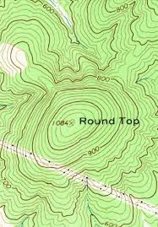
Topographic Map
Topographic Map- has contour lines that show elevation

Slide 4
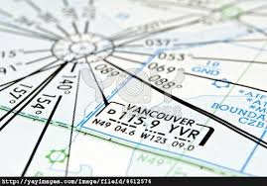
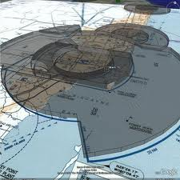
Aeronautical Map
Aeronautical Map- info about flight paths that help planes know where their path is

Slide 5
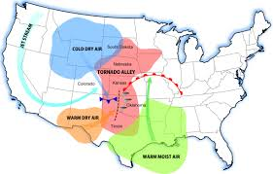
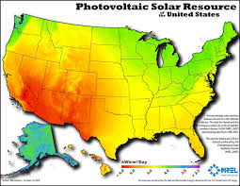
Weather Map
Weather Map- a map showing the state of the weather over a large area

Slide 6
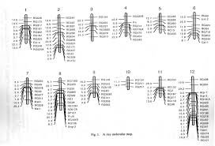
Gene Map
Gene Map- shows the location of one or your genes of your DNA

Slide 7
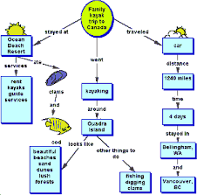
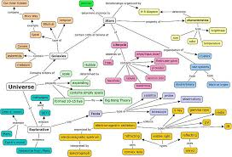
Concept Map
Concept Map- several concepts of maps

Slide 8
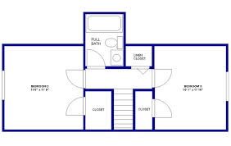
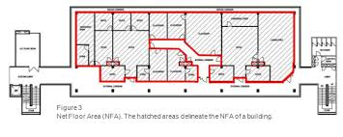
Floor Plan
Floor Plan- an arrangement of a scale diagram of rooms in a building

